Slide 1

True vs. False News for Stakeholders
Advanced Data Science Capstone
Adam Davis
28 September 2020

Slide 2
Question for investigation
False news stories have been making headlines and with the advent of the internet have become a growing problem.
Do true news stories or false news stories have subtle linguistic clues that can be identified by a machine model and used in a classification task?

Slide 3
Text Datasets Used
Buzzfeed dataset: 33 false news stories covering a variety of topics. During our work, we discovered 3 Spanish language stories that we removed.
Rada Mihalcea dataset: 980 news and celebrity gossip stories, 50/50 true/false. News stories are are sourced from mainstream news sites in the US such as ABCNews, CNN, USAToday, NewYorkTimes, FoxNews, Bloomberg, and CNET among others. Each true story has a corresponding intentionally false story created by a human being.
Snopes dataset: 116 stories marked true or false in a set of 312 news articles classified as one of 5 values on a true/false spectrum (false, mostly false, mixed, mostly true, true)
Total: 1126 stories with full text, 555 true, 574 false.

Slide 4
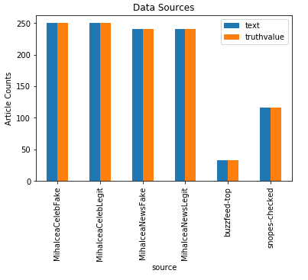
Dataset story breakdown

Slide 5
Dataset stakeholder note
We collected and trained the full text of the news stories in each dataset.
While there are several online factchecking organizations, none provide an API available that would allow an easier collection of true vs. false news stories.
After an extensive search, we found a total of 1126 news stories that we could use; this is not nearly enough. The small amount of data impacted the accuracy of our models.

Slide 6
Use Case
As a consumer of news content, I would like to be able to identify news as true or false in a consistent, accurate way.

Slide 7
Results
This is a binary classification task, so we used Accuracy as our metric.
We used binary crossentropy as our loss function.
Published papers on similar tasks obtain accuracies between 42% and 63%.
We obtained 59% accuracy using both Support Vector Machine and Convolutional 1D deep learning models.
 | Embedding | Accuracy
Published Results:
Salvetti, Lowe, Martin
True vs False (Naïve Bayes) | Bag of Words | 51.14%
True vs False (Naïve Bayes Multinomial) | Bag of Words | 42.71%
Shu, Mahudeswaran, Liu
Politifact | Word2vec | 63.3%
BuzzFeed | Word2vec | 62.3%
Our Results:
Model: Naïve Bayes | Bag of Words 2 ngram | 50%
Model: Naïve Bayes – 2 ngrams | Bag of Words Tf-idf | 46%
Support Vector Machine | Bag of Words Tf-idf | 59%
Deep Learning:
Convolutional 1d | Bag of Words 1 ngram | 59%
Convolutional 1d | Bag of Words 2 ngram | 58%
Densely connected | Bag of Words tf-idf 2ngrams | 54%
Convolutional 1d | Bag of Words tf-idf 2ngrams | 58%

Slide 8
Final Report
Full word document for stakeholders available at:
https://github.com/adamx97/Data-Science-Advanced-Capstone/blob/master/Final%20Documents/News%20Truthiness%20Architectural%20Decisions%20Document.docx

Slide 9
Link
My github repo has the final word document, this powerpoint, all notebooks and Python scripts.
https://github.com/adamx97/Data-Science-Advanced-Capstone

